Slide 1

BE PROJECT ON
Influence of
Emotional Intelligence
for Professional Growth
Jayana Shah 171040
Sumedha Grover 171117
Aashish Waghela 171002
Date of presentation:14/05/2021
Under the guidance of: Alvina Alphonso
St. Francis Institute of Technology
Department of Information Technology

Slide 2

CONTENTS
Introduction
Literature Review
Problem definition & Proposed solution of project
Scope of project
System description of project
Hardware & software requirements
User Interface Design
Results and Discussions
Conclusions
References

Slide 3
INTRODUCTION
The Emotions of humans in every part of a life is usual and unavoidable, it can uplift or cast down a person facing different situations in each moment.
Emotional intelligence (EI), or the ability to perceive, use, understand, and regulate emotions, is a relatively young concept that attempts to connect both emotion and cognition.
In a LinkedIn’s survey of 2,000 business leaders “57 percent of employers said soft skills are the first thing they look for when searching for new employees.”
Hence how emotions affect the learners’ learning and having cognitive thinking determines the success of a learner as well as its potential in professional growth.
Notes:
Good Morning sir/madam,
Today i and my fellow team members are here to present to you our topic for be presentation influence of emotional intelligence for professional growth.
Throughout life, our feelings influence the choices that we make. We watch TV shows that make us laugh or cry. We avoid people that scare us. We eat until we feel satisfied.All this have one thing in common i.e. Emotions.
Why need of Emotions?(1st point)
What is Emotional Intelligence? (2nd point)
Why Emotional intelligence?(3rd point + below content)
The survey shows business leaders value graduates with knowledge on how to lead and work within a team, those with clear communication and collaboration skills, and people who demonstrate good time management, understanding how to motivate others, being able to navigate tricky personalities and allowing everyone to be heard in their contributions– these skills all stem from having empathy and social awareness.

Slide 4
LITERATURE REVIEW-(I)
Sr no. | Paper Name | Review | Analysis/Limitation
[1] | Emotional Intelligence (EI) A Therapy for Higher Education Students.(2017) | Author investigates the need to design and develop an emotional intelligence curriculum for students in higher education. | To reduce the high emotions in college students the emotional intelligence curriculum must be included under professional guidance of psychology trainers. Limitations: On account of addition of a module in curriculum may generate a burden on students if not accepted optimistically.
[2] | Study of Emotional Intelligence and Learning Strategies(2011) | Research enlightens readers regarding the importance of learning strategies and emotional intelligence in university students’ and their interdependence on each other. | The research study incorporates the objectives that are mainly giving the concern to the relationship between the factors of EI and the learning strategies. Limitations: There may be the possibility of the educational institutions to not take their responsibility more seriously which may create a problem in inculcating the strategies in students more efficiently
Notes:
1)The first paper states about the need of ei in higher education as the students may lack soft skills. They used 4 factors out of which we used 3 factors namely social skills , motivation and stress management to demonstrate emotional intelligence.
Using this paper we incorporated idea to have basic need of ei as a component in higher studies. Thus, we have tried to add it as an outcome rather than a curriculum subject which may be burdensome if not accepted optimistically.
2)In the second paper author recommended administration of Ei and learning as their diagnostic measure since not only intelligent mind is enough for good life but an emotional and strategic mind is more important.
We made use of this paper to include major learning factors as a need to enhance ei’s growth for an individual.

Slide 5
LITERATURE REVIEW-(II)
Sr no. | Paper Name | Review | Analysis/Limitation
[3] | Emotional intelligence in engineering education (2017) | During this study, emotional intelligence levels of engineering students from different universities in Turkey were investigated | The connection between EI and variables (having similar hobbies in lifestyle, having an engineer in family, state of professional pessimism) was evaluated. Limitation: No significant difference was found between the students’ EI scores in terms of gender and age in the study.
[4] | The Influence of Emotional intelligence for Academic Achievement (2012) | The findings of the study hold important implications on the value of Emotional Intelligence and their relationships to student’s academic performance especially among pre-service teachers. | Since the respondents are future educators, they should have good hand-in hand relationship with EI. They should be able to take on the challenge to educate the young generations and adapt to the demanding and stressful working environment. Limitation: No significant relationship was found between emotional intelligence and students’ academic achievement.
Notes:
3) the third paper focuses on the engineering students.Engineering students who do not have professional pessimism were see to have higher ei score. Also it was seen to have no significance difference between the students EI scores in terms of gender and age. Similar to which in our demonstration too we found age to be a negligent factor affecting ei. But gender being the affecting factor for EI scores.
4) Next paper mainly is used to see if academic achievement will depend on the ei scores. But it was found in the paper that no significant relationship existed between them. This paper also suggests that Ei will enhance the growth in an individual's caliber which is what we have incorporated for our study.

Slide 6
LITERATURE REVIEW-(III)
Sr no. | Paper Name | Review | Analysis/Limitation
[5] | The Impression of Emotional intelligence for University Students’ Academic Performance(2019) | Study that there is no to a very limited number of studies who all have investigated the role of emotions in the process of capturing better academic scores through education. | Emotional appearance of the students is the key to understanding the permutation and combination of the Intellectual complexities of life over a period of time. Limitations: Number of data collected was small which can’t be used to analysis the entire world
[6] | An Impact of Emotional intelligence for the Academic Achievement of the student: A case Study on students of Career Point University (2017) | The impact and importance of emotional intelligence for students at Career Point University | Focuses greater on the emotions that in turn help in building the academics and future scope of students. Limitations:Accordingly the lacking factor could be found in a student in the process but in what ways they can improve upon those lacking factors is not specified.
Notes:
5) the fifth paper also determines that academic performance is not entirely dependent on ei since the individuals had high ei scores despite which their academic scores are not relatively high comparatively. So the author tends to explain that along with the development of ei the teachers should also focus on intellectual development. Which in turn will lead to all round development of students. This development will further help in growth opportunities of students in career prospects which we are trying to establish.
6) This paper has described the three main models for defining ei namely Ability, Mixed and trait. Of which we have used the mixed model that outlines the factors we have used in our study. The mixed model has five factors on which we have added one more factor to determine ei of the individual. Also contrasting to the previous two papers it was found that academic performance correlates with the levels of ei of an individual. This helps to state that ei is needed for better academic scores and can built employable students. Their future study states to help students to develop themselves for higher education which we have tried to attain.

Slide 7
LITERATURE REVIEW-(III)
Sr no. | Paper Name | Review | Analysis/Limitation
[7] | Improved Learning with Emotional Intelligence and Analysis using Neural Networks (2017) | This study examines how emotional intelligence recounts academic performance. The proposed work uses Observe, Amend and Analysis (OAA) method and Multi-Layer Perceptron training. | The results of the implementation depicts that learning with positive emotion produces good outcomes compared to the negative emotions. Limitations: No description on how to improve or how to shift towards positive emotions.
[8] | Modified K-means Algorithm for Emotional Intelligence Mining (2015) | Focuses on minimizing the problems of the K-means algorithm by some modifications in it and applying it to the numerical dataset. | Modified K-means worked more efficiently than basic K-means on EI data. Limitation: On how this information can be used in helping the organization with team formation and decision making process.
Notes:
7) in seventh paper author has used neural networks for calculating the ei levels for a real time dataset. The results of implementation depicts that learning with positive emotion will produce greater levels of ei. And increasing confidence will help develop positive emotions. But there are no remedies provided for such people to improve on how to shift towards positive emotions.
8) Next paper focused on the clustering algorithm kmeans and a modified version of it for better results. Whole paper just focuses on the algorithms working and implementation and not on how it will help an individual or organization for their betterment.

Slide 8
LITERATURE REVIEW-(IV)
Sr | Paper Name | Review | Analysis/Limitation
[9] | Machine Learning on Emotional Intelligence and Work Life Balance (2015) | The author examines how far the employees are conscious of their own self and found the ideas and views of an individual about themselves and others. | The finding tells that emotional intelligence is a developing ability; it is likely that the accumulated life experiences contribute to Emotional Quotient. Limitations: Classification and Clustering algorithms provide similar results for the given data.
[10] | Assessing the impact of personality and psychological ownership in determining emotional intelligence of information technology(IT) employees using curve fit regression (2017) | Claims for significant relationship between personality, psychological ownership and Emotional Intelligence were made. | The correlation of employees’ well-being, tolerance of IT has being considered. Here, the performance of the employees has being differentiated into individual context and task oriented. Limitation:This research has been confined only to the state of Tamilnadu.
Notes:
Author finds high levels of ei helps to have job satisfaction and high productivity. Both the clustering and classification methods of machine learning were implemented. But it was seen that both the classification and clustering algorithms had similar results. So the differentiating factor could not be well perceived. So my taking guidance from this research we included the classification algorithms for carrying out our study. Also in their study they found age as significant factor affecting levels of ei . Old people were found to have greater ei levels than younger ones.thus,this feature is included in our implementation.
lastly this paper tells about the significant relationship between personality, psychological ownership and Emotional Intelligence. They have differentiated performance of employees into task oriented and individual context. Which makes the research quite constraint also the study was confined to a very small location of tamil nadu.

Slide 9
PROBLEM DEFINITION
To maintain an impeccable balance between professional life and emotional intelligence and find certain correlation parameters which will turn out to be deciding factors for monitoring the linking between them.

Slide 10
PROPOSED SOLUTION
The proposed system provides tentatively individual's current emotions that is faced in day to day life. Then observing the results provided by the individual one after another, thus each individual can then make the best use of self-emotional transitional states for his/her further self- improvement.
Making use of conventional machine learning algorithms like KNN, Naive Bayes, Logistic Regression to help in building the correlation between emotional intelligence and professional growth in the individual.

Slide 11
SCOPE OF PROJECT
The project maps the emotional intelligence of people with age group from 20-30 with-in South-Asian Countries.
1) Intra-personal Component
2) Interpersonal Component
3) Stress Management
4) Adaptability
5) General Mood.
a) Stress management
b) Self Awareness/Social Awareness
c) Self Regulations
d) Empathy
e) Social Skills
f) Motivation
3. Input parameters in the database are derived from the questionnaire having options as follows: Strongly Disagree(1 point), Disagree(2 point), Neither Agree nor Disagree(3 point), Agree(4 point), Strongly Agree(5 point).
Notes:
1 st) same
2nd )The major factors considered while mapping the emotional intelligence on professional growth are :Intra-personal Component, Interpersonal Component, Stress Management, Adaptability, General Mood. According to these factors we subdivided them into:
a) Stress management b) Self Awareness c) Self Regulations d) Empathy e) Social Skills f) Motivation
3rd) based on likert’s scale the

Slide 12
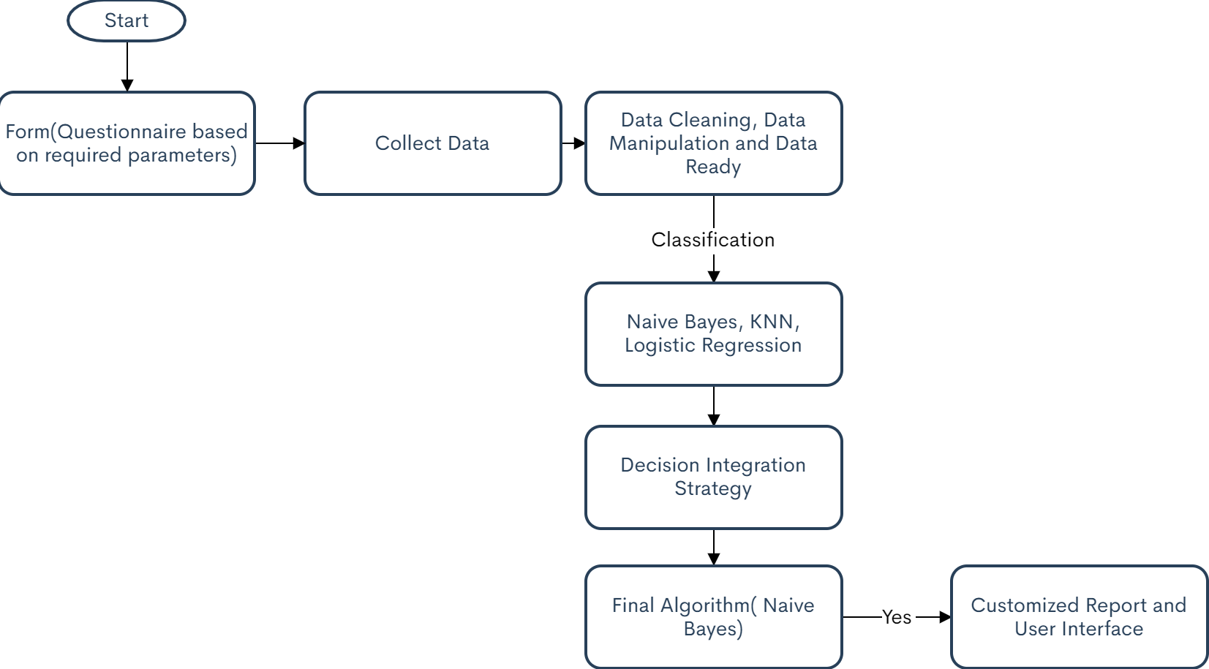
SYSTEM DESCRIPTION
logistic Regression
Notes:
For the system diagram we first created a Questionnaire based on the factors Stress management, Self Awareness, Self Regulations, Empathy, Social Skills and Motivation. The questionnaire was made of 37 questions tested on 196 respondentes.Of which 103 were males and 93 were females. This collected respondents data was further cleaned, manipulated and made system ready. Further classification algorithms like knn, naive bayes and logistic regression were applied and the accuracy was found. Also the major factors affecting ei for professional growth were visualized. Then as seen in the diagram decision integration strategy were applied to find the best optimal algorithm. And hence using this algorithm a user interface was generated to get a customized report for ei in an individual.

Slide 13
HARDWARE AND SOFTWARE REQUIREMENTS
Hardware:
Processor –i5 and above
RAM-Minimum 4GB
Hard Disk-500GB and above
Minimum internet speed
Software
Python 3.8
Anaconda Navigator
Visual Studios
Notes:
none

Slide 14
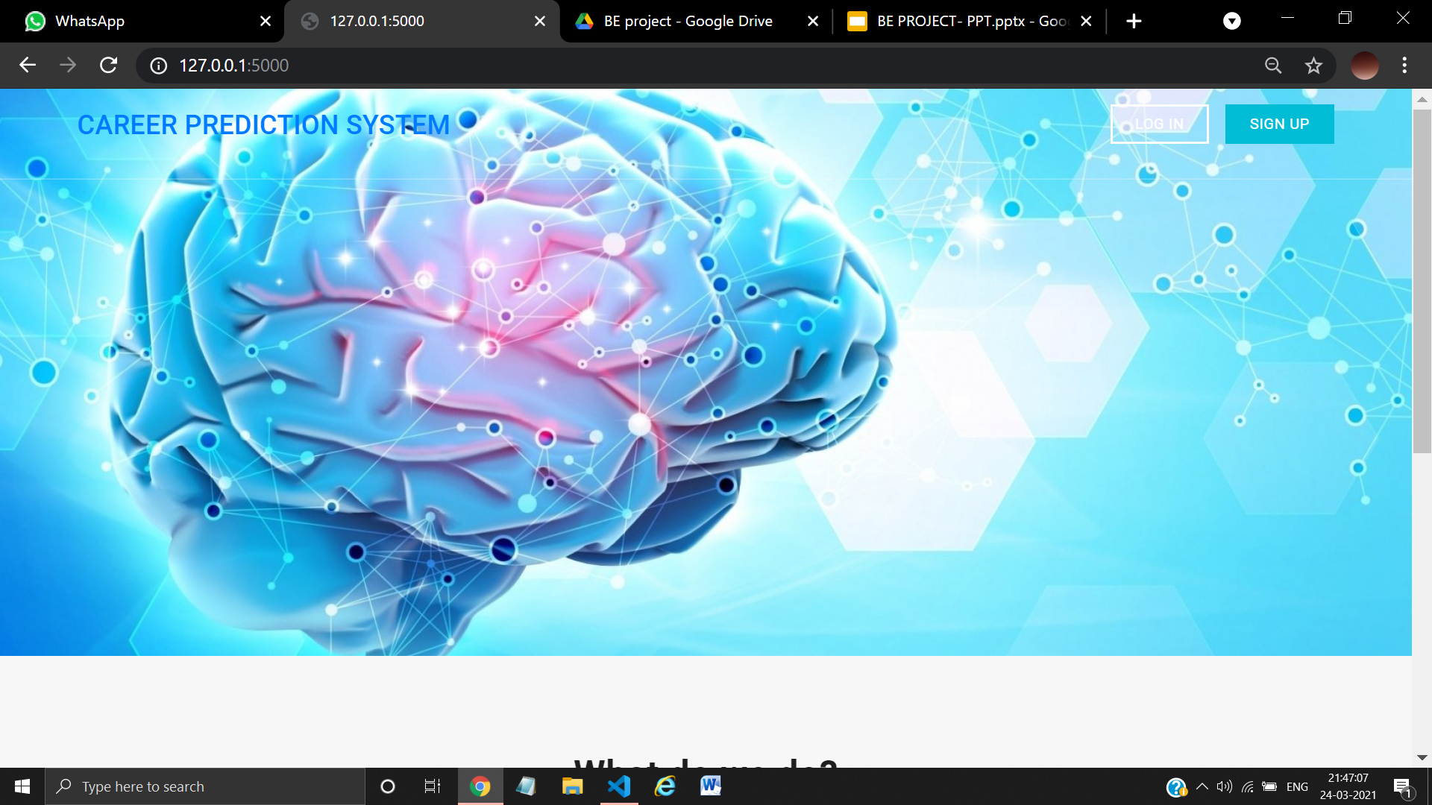
USER INTERFACE DESIGN
fig:1 Home Page
Notes:
explain in your words.

Slide 15
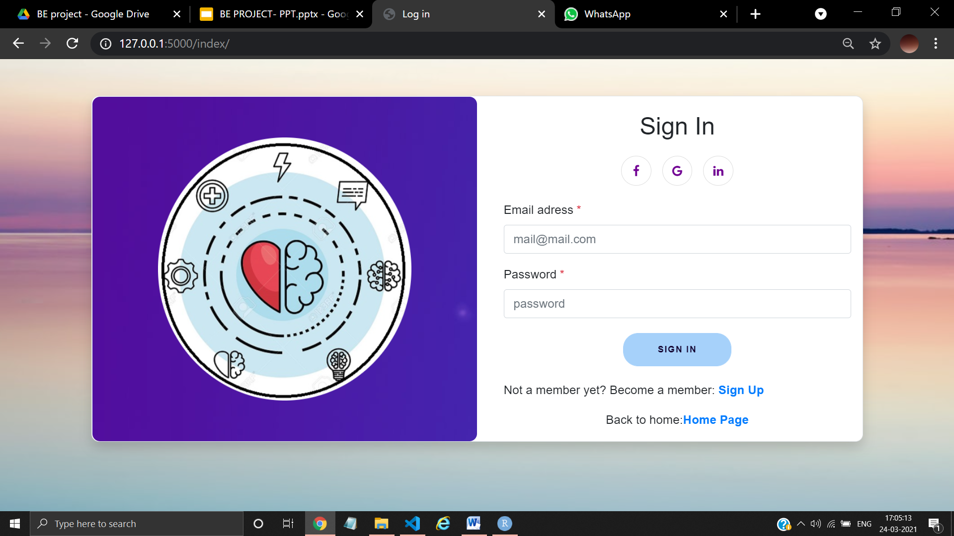
fig:2 Sign in

Slide 16
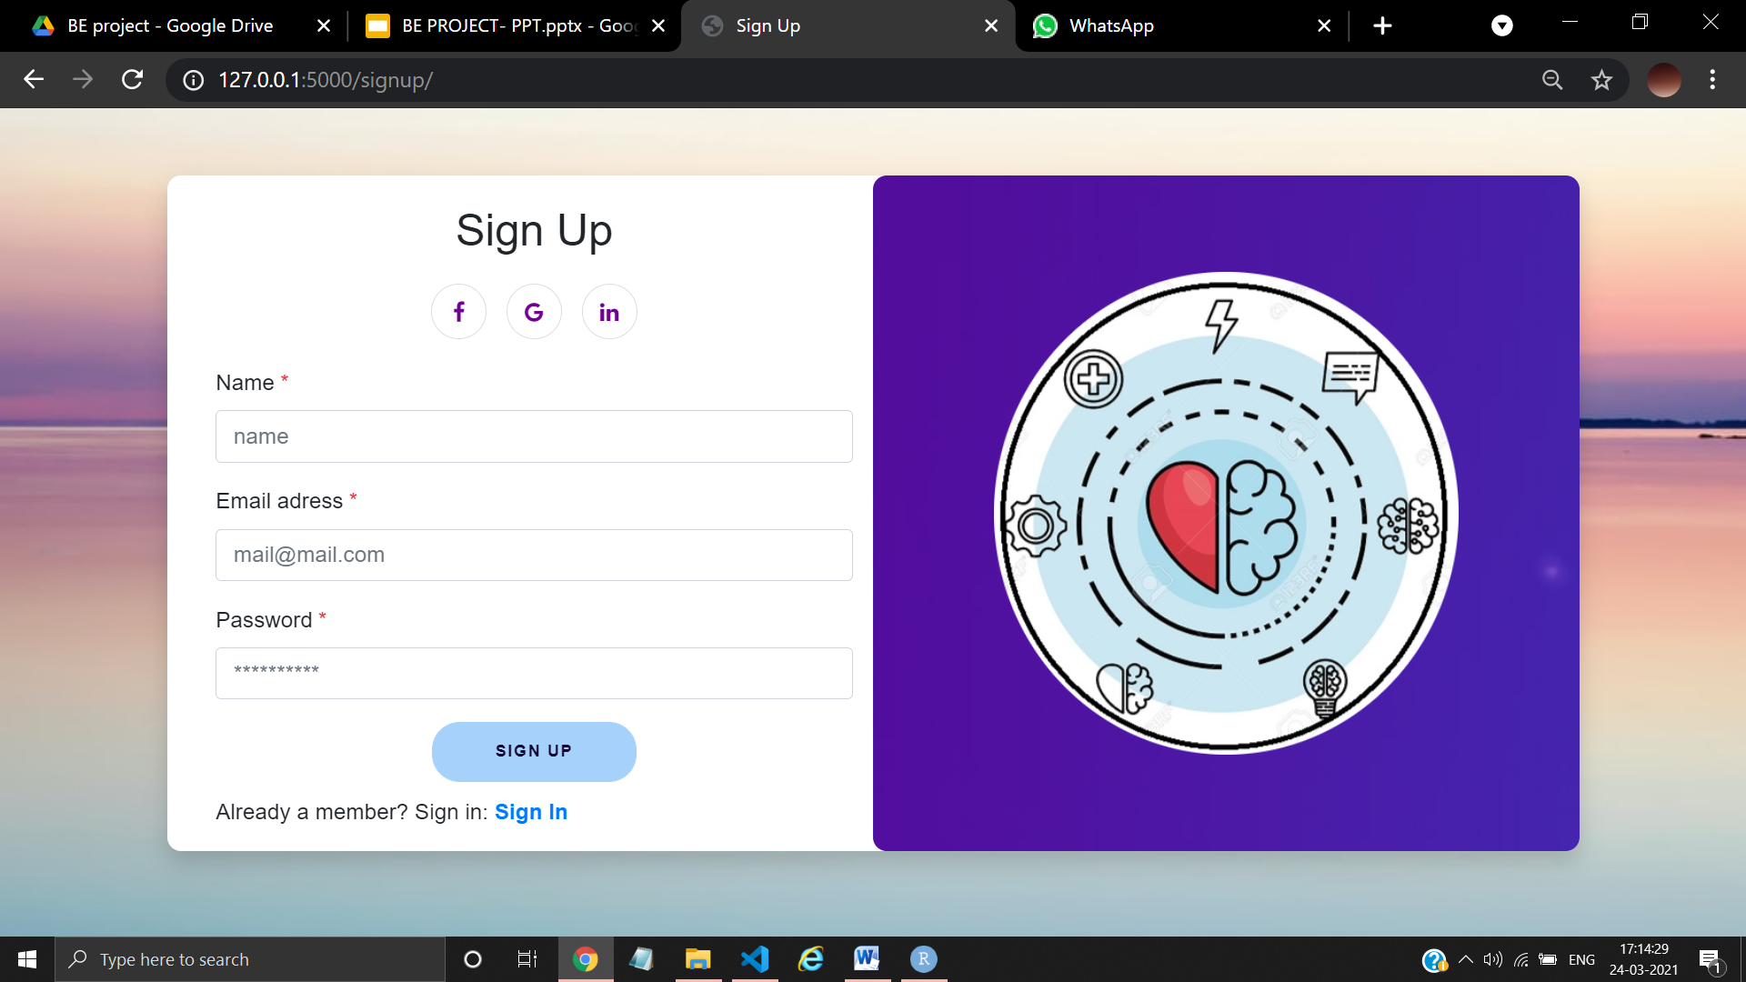
fig:3 Sign up

Slide 17
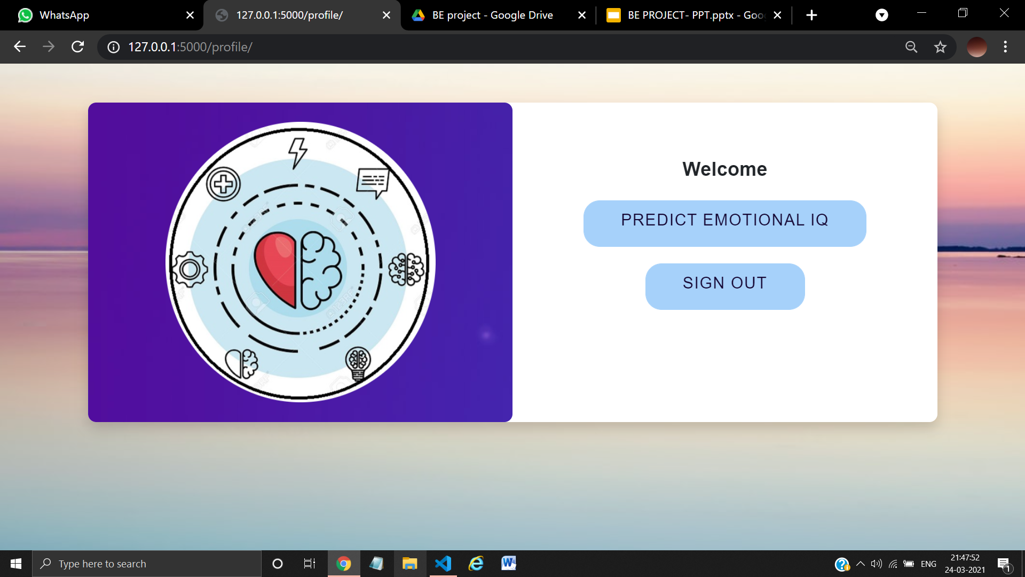
fig:4 Home page

Slide 18
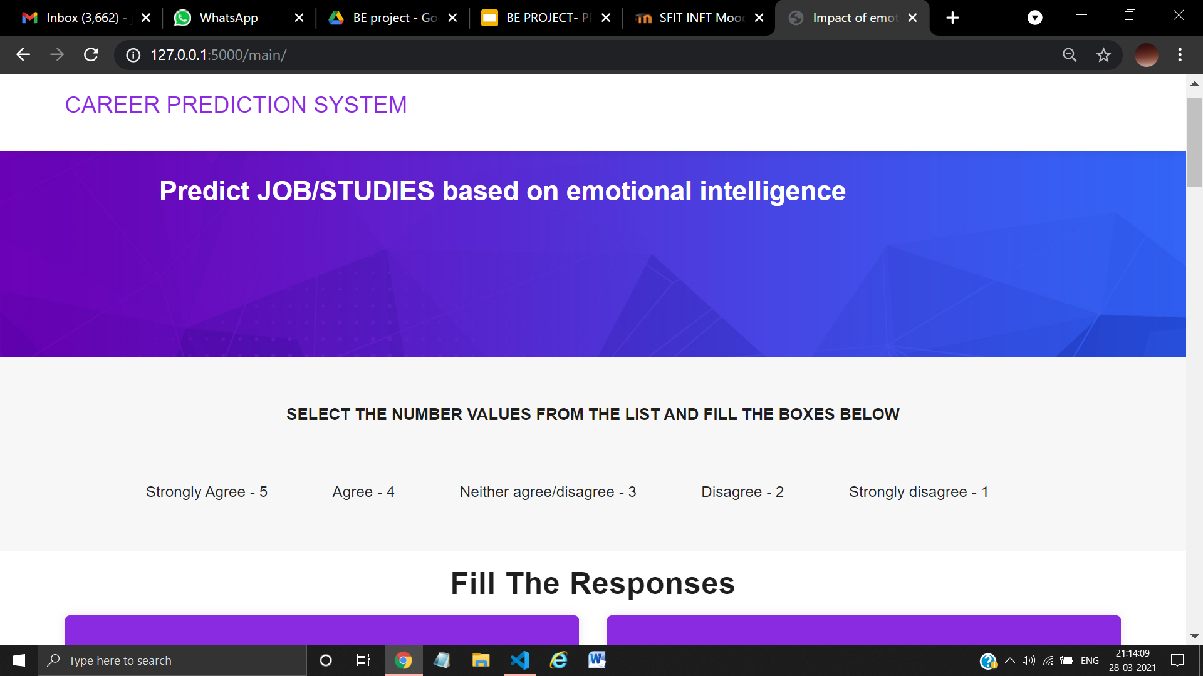
fig: 5 Prediction page-1

Slide 19
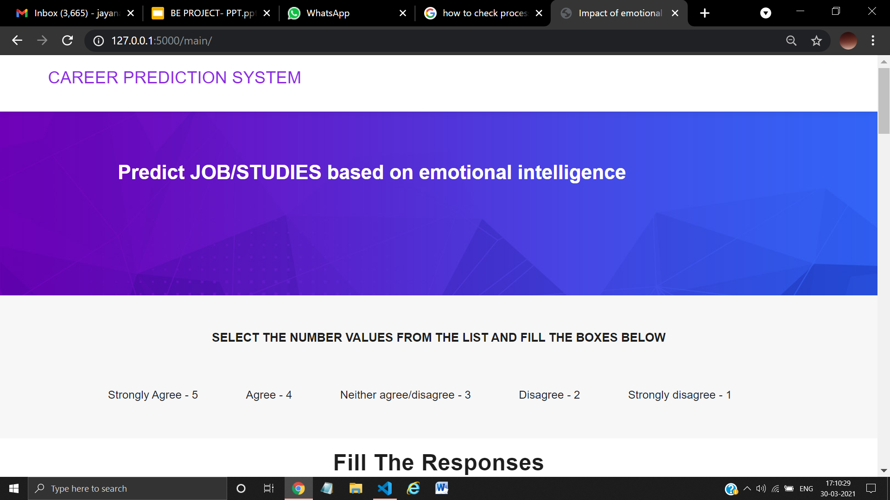
fig: 6 Prediction page-2

Slide 20
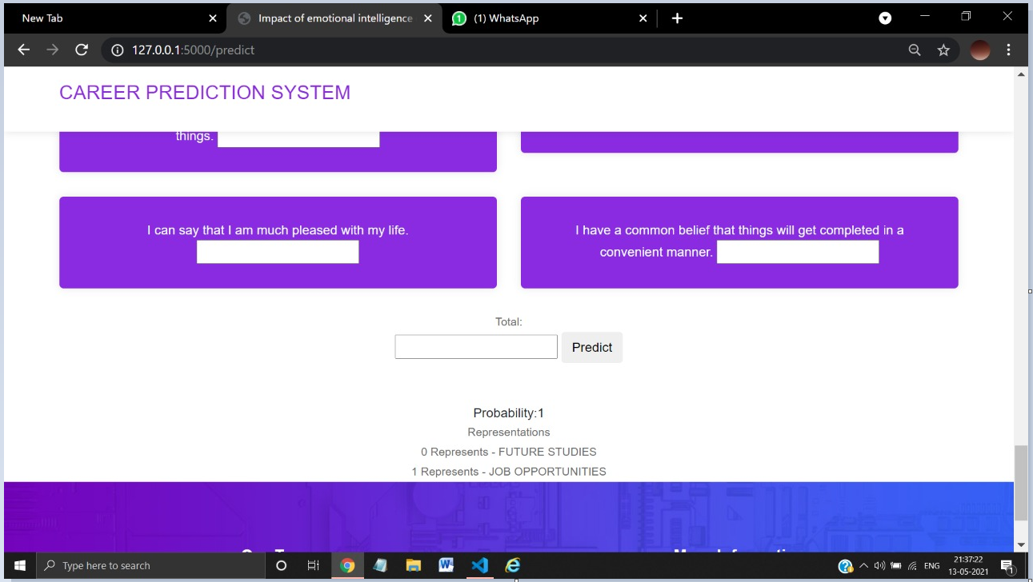
fig:7 Outcome seen as in figure

Slide 21
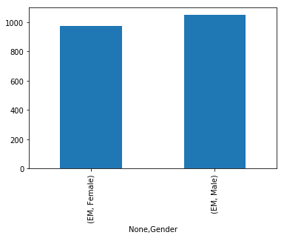
RESULTS AND DISCUSSIONS
Hypothesis-1 (Total Empathy vs Gender)
Here total score of all the males and females respondents are combined using GroupBy property and it it concluded that 'Males' have more empathy as compared to 'Females'. (According the our data)
Empathy
Females
Males
Gender

Slide 22
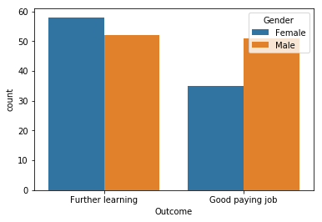
RESULTS AND DISCUSSIONS
2. Hypothesis-2 (Outcome vs Gender)
Our data shows Males opting for Good Paying Job in contrast with the Females who tends to choose Further Learning.
Number of males/females
Outcome

Slide 23
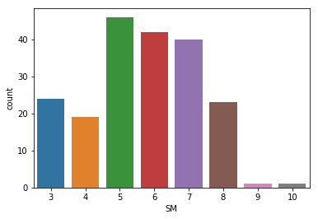
RESULTS AND DISCUSSIONS
3. Hypothesis-3 (Stress in respondents)
The respondents don't show dangerous amount of stress but still shows they are under stress. As people with score 5,6 and 7 comprise of more than 50% thus concluding the fact of having considerate amount of stress in people
23.47%
21.43%
20.41%
The values in the graph represent the percentage value of people
12.24%
11.73%
Percentages of people
9.69%
0.51%
Scores of stress related questions

Slide 24
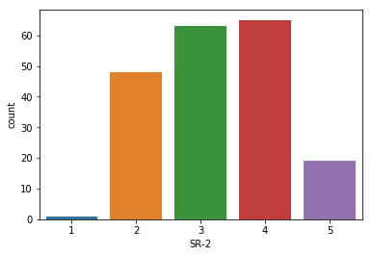
RESULTS AND DISCUSSIONS
4. Hypothesis-4 (Can respondents control their emotions or not.)
Most respondents tends to agree with the question so people lose their control on emotions.
32.1%
33.1%
1- Strongly Disagree
2- Disagree
3-Neither agree nor disagree
4-Agree
5- Strongly Agree
24.4%
Number of votes
The values in the graph represent the percentage value of people
9.69%
0.51%
Emotions

Slide 25
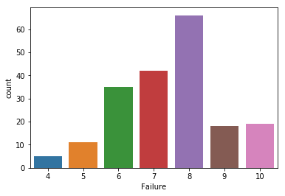
RESULTS AND DISCUSSIONS
5. Hypothesis-5 (Response to failures)
Majority of persons are able to express their failure and have perseverance quality in them. This can be concluded due to the fact that most of the people ie approx 65 with a score concluded that people were able to handle the failures.
33.67%
The values in the graph represent the percentage value of people
21.43%
17.85%
Number of People
9.18%
9.69%
5.61%
2.55%
Scores of Failure related questions
Notes:
tell the external failure was calculated optimistically so no percentage needed to be calculated.

Slide 26
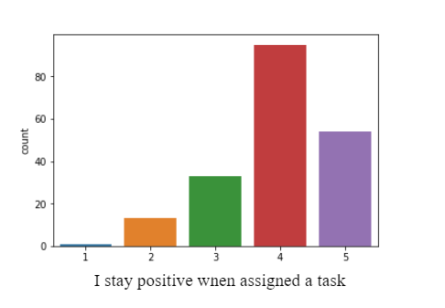
RESULTS AND DISCUSSIONS
6. Hypothesis-6 (Excited to learn new things):
Maximum of the individuals agreed to be excited to learn new things while assigned a task.
48.4%
1- Strongly Disagree
2- Disagree
3-Neither agree nor disagree
4-Agree
5- Strongly Agree
Number of votes
27.55%
16.83%
The values in the graph represent the percentage value of people
6.63%
0.51%
Learn New Things
Notes:
tell the external failure was calculated optimistically so no percentage needed to be calculated.
Since the count of number 4 and 5 are more; we can conclude that people are excited to learn new things.

Slide 27
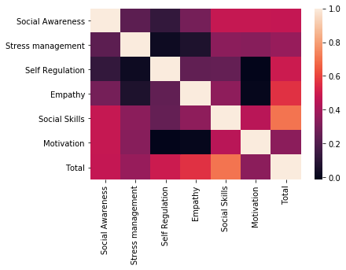
RESULTS AND DISCUSSIONS
7. The most important parameter:

Slide 28
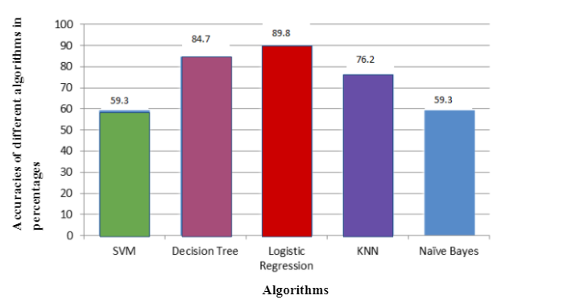
RESULTS AND DISCUSSIONS
Accuracies in percentages(%)
Notes:
On implementing the conventional algorithms the results were found as seen in the figure below. Out of which it was found that logistic regression(89.8%) had the highest accuracy among the other algorithms and thus we have used it for our implementation.

Slide 29
RESULTS AND DISCUSSIONS
Accuracy score of Logistic Regression
0.8983050847457628
 | Precision | Recall | F1-score | Support
0 | 0.94 | 0.89 | 0.91 | 35
1 | 0.85 | 0.92 | 0.88 | 24
Micro average | 0.90 | 0.90 | 0.90 | 59
Macro average | 0.89 | 0.90 | 0.90 | 59
Weighted average | 0.90 | 0.90 | 0.90 | 59
Notes:
The algorithm used in to find the output among different classification algorithm built is :
“Logistic Regression”.

Slide 30
CONCLUSION
Our visualization and the dependency of factors concluded :
1) Job/further learning Vs gender: This analysis found that males tend to opt for securing a job rather than going for higher studies and on contrary, females tend to go for further learning(higher education).
2) Total Empathy Vs gender: Our analysis on the collected data found males to be more empathetic over females.
3) The empirical analysis found five of the six factors (except empathy) are significant for the
age group 20-30.
4) The most significant factor impacting over emotional intelligence for growth was found to
be social skills of the individual.
We analyze his/her emotional intelligence and evaluate the results for applying for a job or future studies. Study also concludes that EI is the aggregation of the innate characteristics and the knowledge and skill that individuals acquire and develop throughout their lifetime.

Slide 31
REFERENCES-(I)
[1] Robert P Machera, Precious C Machera .,” Emotional Intelligence (EI) A Therapy for Higher Education Students ”, Universal Journal of Educational Research 5(3): 461-471, 2017
[2] Ramezan Hasanzadeh, Fatema Shahmohammadi B .,” Study of Emotional Intelligence and Learning Strategies ”, International Conference on Education and Educational Psychology (ICEEPSY), Procedia – Social and Behavioral Sciences 29 :1824 – 1829,2011
[3] Mehmet Tekerek,Betul Tekerek .,” Emotional intelligence in engineering education ” , Turkish Journal of Education TURJE, Volume 6 Issue 2,2017
[4] Maizatul Akmal Mohd Mohzana, Norhaslinda Hassan , Norhafizah Abd Halila ,” The Influence of Emotional Intelligence on Academic Achievement ”, 6th International Conference on University Learning and Teaching (InCULT ),In 2012, Procedia - Social and Behavioral Sciences 90 ( 2013 ) 303 – 312.
[5] Praveen Kumar Pandey, Namita Gupta, Prashant Kumar Pandey, Pratibha Giri .,” The Impression of Emotional Intelligence on University Students’ Academic Performance”, International Journal of Recent Technology and Engineering (IJRTE), ISSN: 2277-3878, Volume-8 Issue-3, September 2019

Slide 32
REFERENCES-(II)
[6] Garima Tyagi and Ashish Gautam .,” An Impact of Emotional Intelligence on the Academic Achievement of the student: A case study on students of Career Point University”, International Journal of Advanced Scientific Research and Management (IJASRM), Vol. 2 Issue 7, July 2017.
[7] I.Samuel Peter James, Dr. P.Ramasubramanian, D.Magdalene Delighta Angeline .,” Improved Learning with Emotional Intelligence and Analysis using Neural Networks”, IEEE, International Conference on Computational Intelligence and Computing Research,2017
[8] Mr.Anand D.Khandare,.” Modified K-means Algorithm for Emotional Intelligence Mining”. IEEE, International Conference on Computer Communication and Informatics (ICCCI), 2015, Coimbatore, INDIA
[9] P. Julia Grace,N. Nasreen Banu.,” Machine Learning on Emotional Intelligence and Work Life Balance”, International Journal of Computer Applications (0975 – 8887),Volume 116 – No. 10, April 2015
[10] S.Anjali Daisy, Dr. C. Vijaya Bhanu,Deena Maria Bonaparte.,” Assessing the impact of personality and psychological ownership in determining emotional intelligence of information technology(IT) employees Systems (ICISS ),2017

Slide 33
Questions??
Thank You!

